Slide 1


Amazon Electronic Products Network Analysis
EE-558 A Network Tour of Data Science
Süha Kagan Köse - Tao Sun - Xiangzhe Meng - Xingce Bao

Slide 2


Introduction
Amazon is reshaping and recording our life
Invisible social network
By purchasing, reviewing or just viewing —>
Products in Amazon are connected together
Analyse electronic product network

Slide 3
Data acquisition & exploration
The subset Electronics of Amazon Product Dataset, provided by Julian McAuley, UCSD
Product metadata (descriptions, category information, price, brand image features and product links: also viewed/ also bought)
Millions of reviews (reviewer ID, ratings, text) spanning from May 1996 to July 2014
Metadata of Electronics and 5-core review data of Electronics

Slide 4
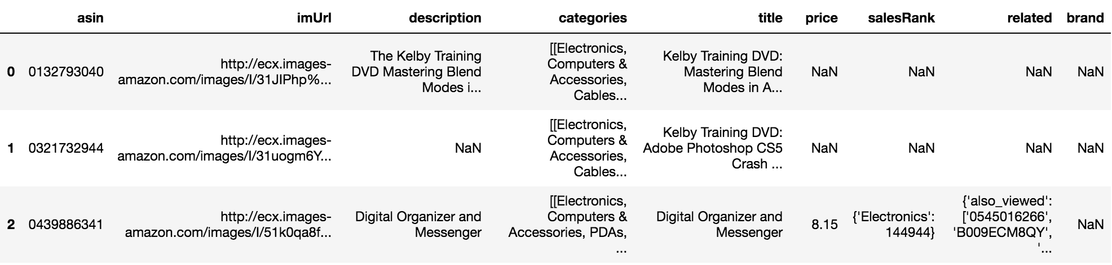
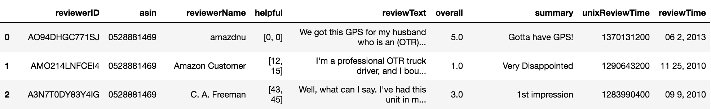
Before preprocessing
Electronic product metadata
Electronic product reviews

Slide 5
What we mainly did for data preprocessing …
Drop useless columns from two datasets. Only keep columns asin (product ID) & related for product dataset and columns asin & reviewerID for review dataset.
For review dataset, reform the dataset, set product asin as index. For each product asin, we collect a list of reviewerID which stand for those who have commented on this product.
For product dataset, drop products whose related column value is Nan.
For each product, check the related product list and drop those products which are not in the product dataset (e.g. other category product).
For review dataset, only keep reviews concerning the products presented in the product dataset and drop the others.

Slide 6
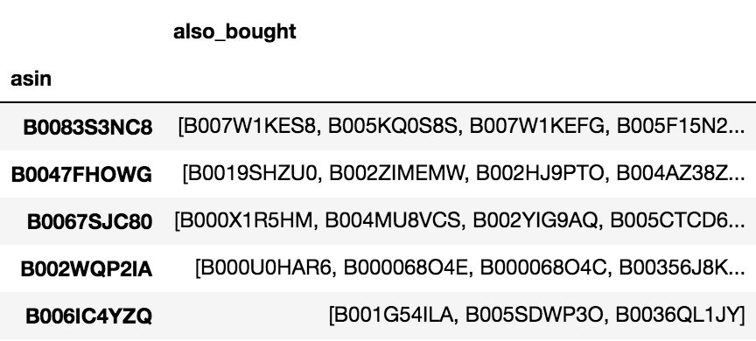
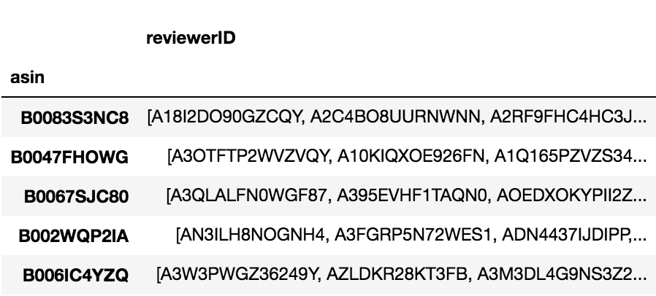
After preprocessing
Electronic product metadata
Electronic product reviews

Slide 7


Study on MacBook and Surface
Surface
MacBook

Slide 8
Network Building
Collecting Nodes
“Core&Layer” Method
Define one product as the “Core” and the corresponding “also-bought” products as the first “Layer”
A new layer is composed of all of the “also-bought” of the products in the previous layer
We only use two layers in the project considering the size of our dataset as well as the tractability

Slide 9
Network Building
Labeling Nodes
Two cores: Mac & Surface
Mac : Surface = 743 : 499 with 134 duplicates
Assign all duplicates to Surface Group
Mac : Surface = 609 : 499 Total: 1108

Slide 10
Network Building
Weighing Edges
Two different approaches
Weight = F(# Shared “also_bought”)
Weight = F(# Shared “also_bought”, # Shared Reviewers)

Slide 11
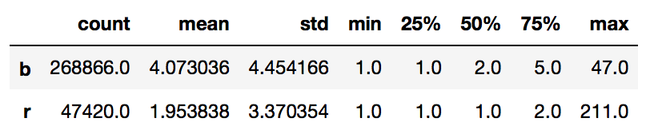
Network Building
Weighing Edges
How to normalise two features?
Skewed distribution of non-zero elements
Choose mean to normalise

Slide 12
Spectral Graph Theory
From Similarity Matrix to Laplacian Eigenmaps
Similarity = Weight / Max_Weight
Weight itself actually represents the similarity
“Distance”? No, because no better results.

Slide 13
Spectral Graph Theory
From Similarity Matrix to Laplacian Eigenmaps
Comparison between two weight definitions
Information of reviewers is of importance
also_bought/reviewer: .8 / .2 -> .5 / .5 -> .2 / .8
Getting better and better results

Slide 14
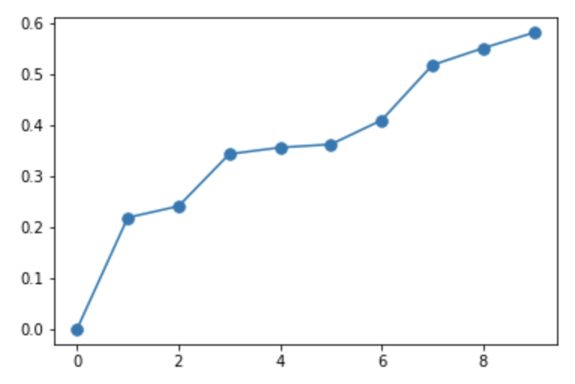
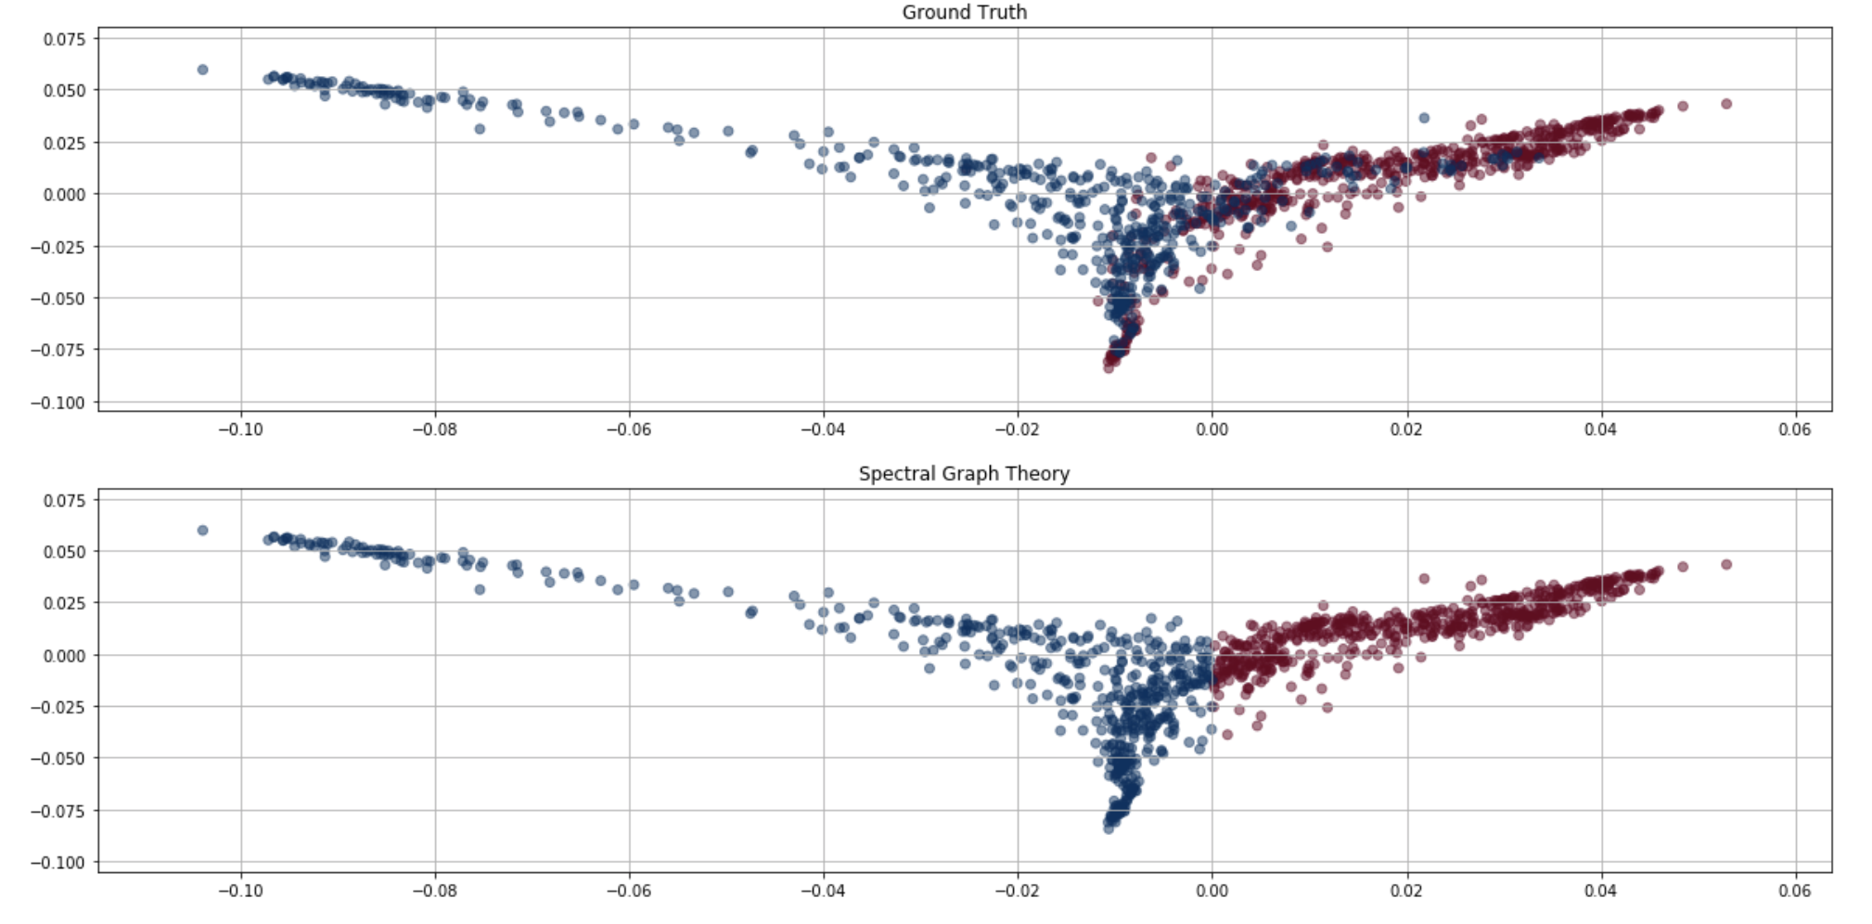
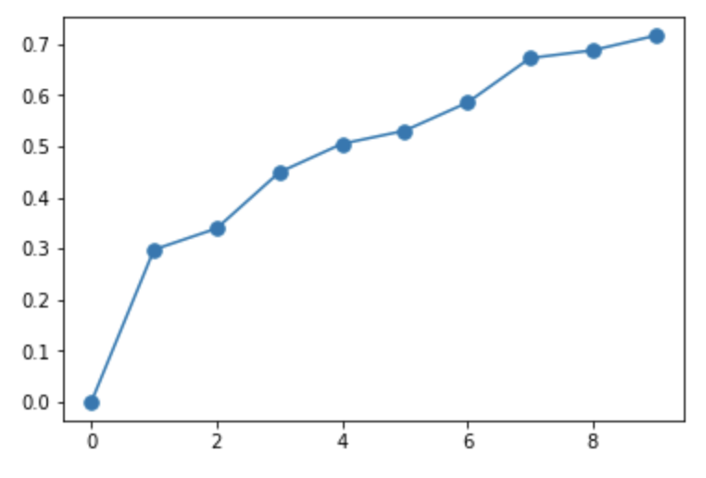
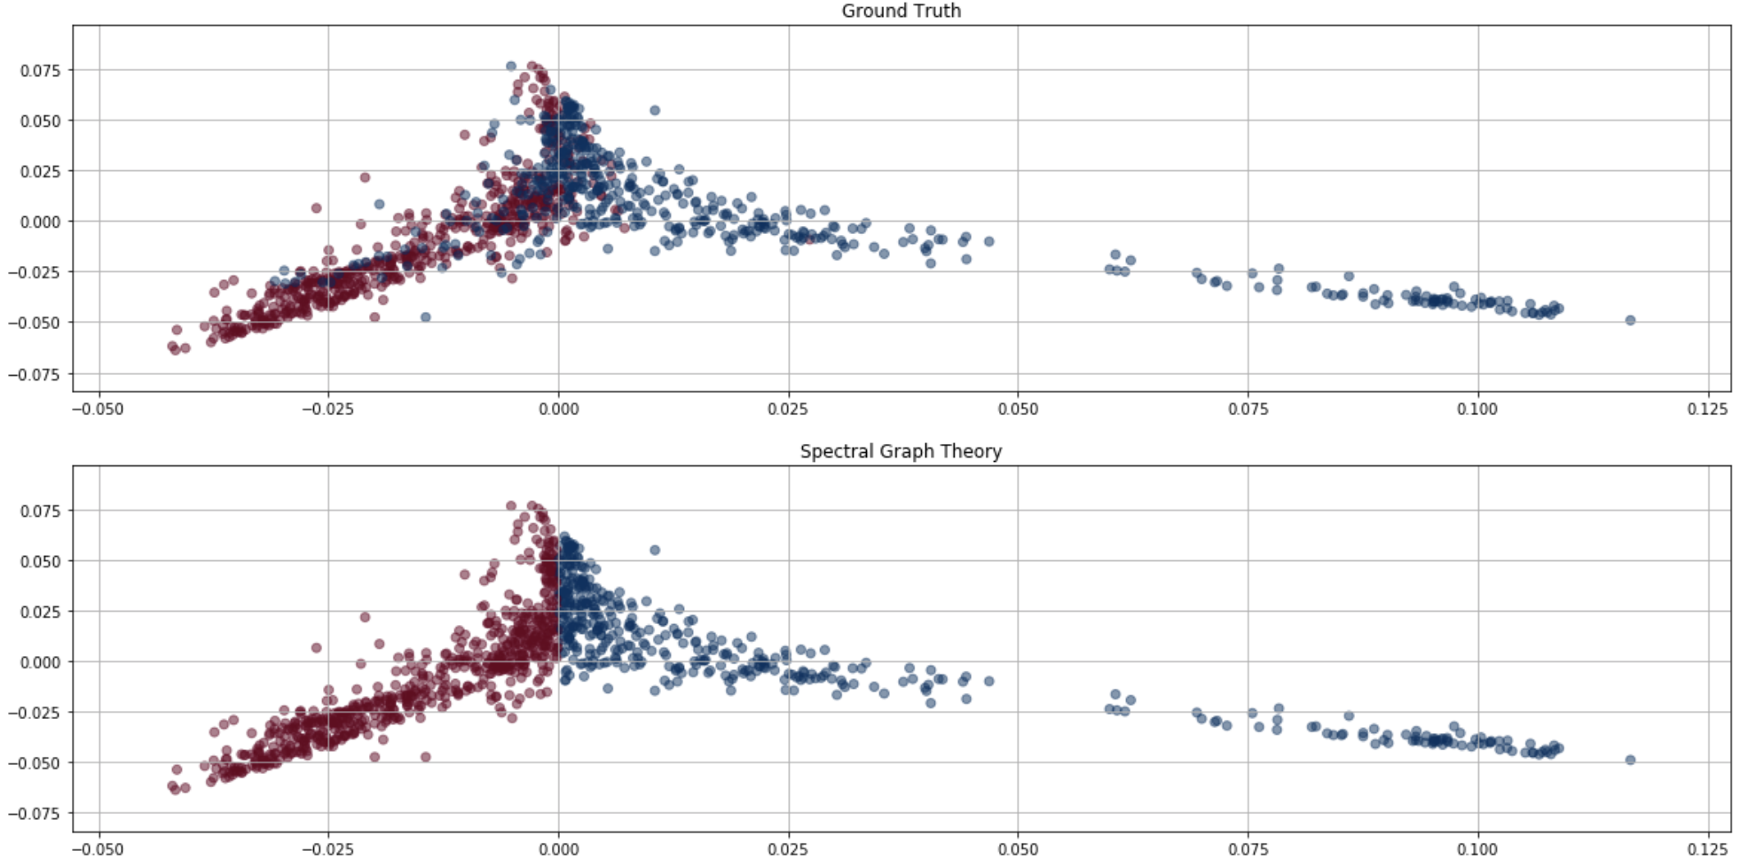
Spectral Graph Theory
From Similarity Matrix to Laplacian Eigenmaps
Error: 17.24 %
“also_bought”
Error: 15.61 %
With Reviewer
Weigh: 0.2/0.8

Slide 15

Network Graph
Volume of the dataset is too large (# of products)
NetworkX doesn’t work well anymore
D3.js, a JavaScript library for producing dynamic, interactive data visualizations in web browsers
2 graphs concerning the relationship among products
200 nodes and 1830 links

Slide 16
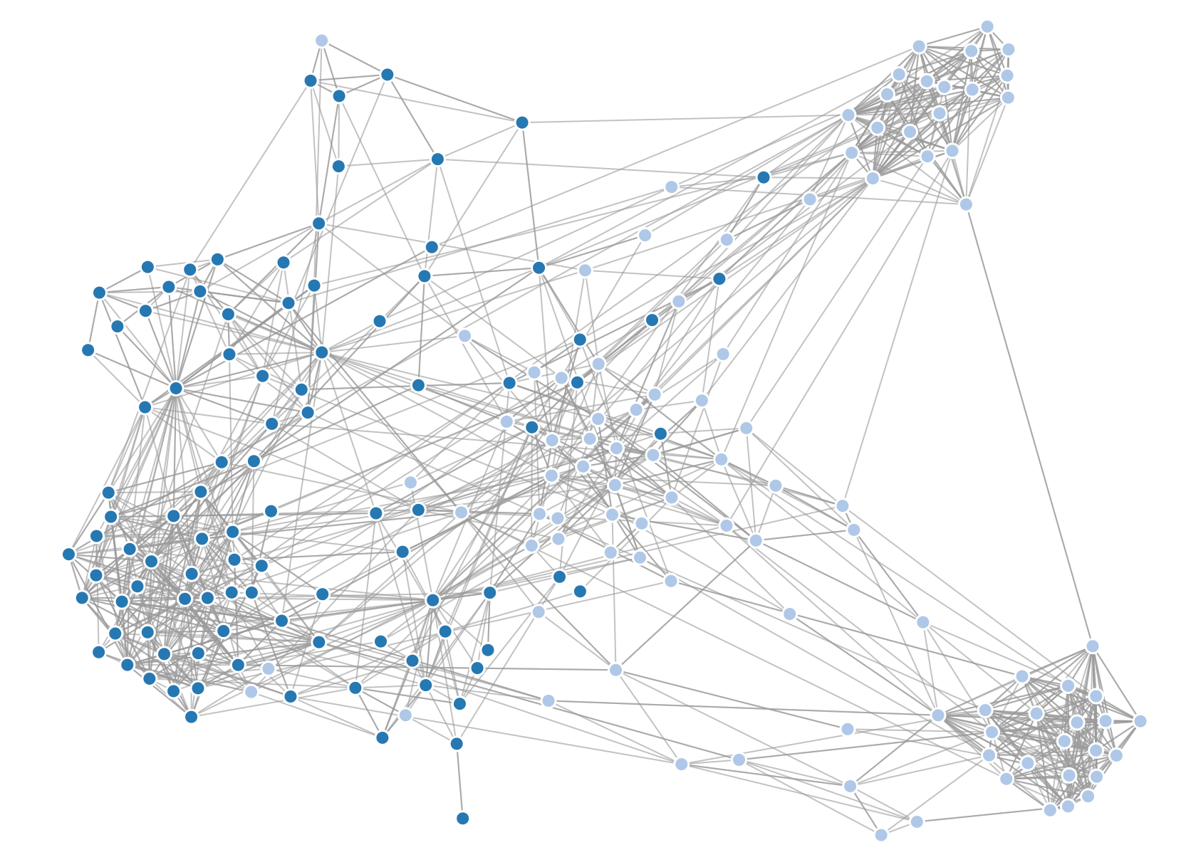
Random Network
https://xiangzhemeng.github.io/ntds/index.html

Slide 17
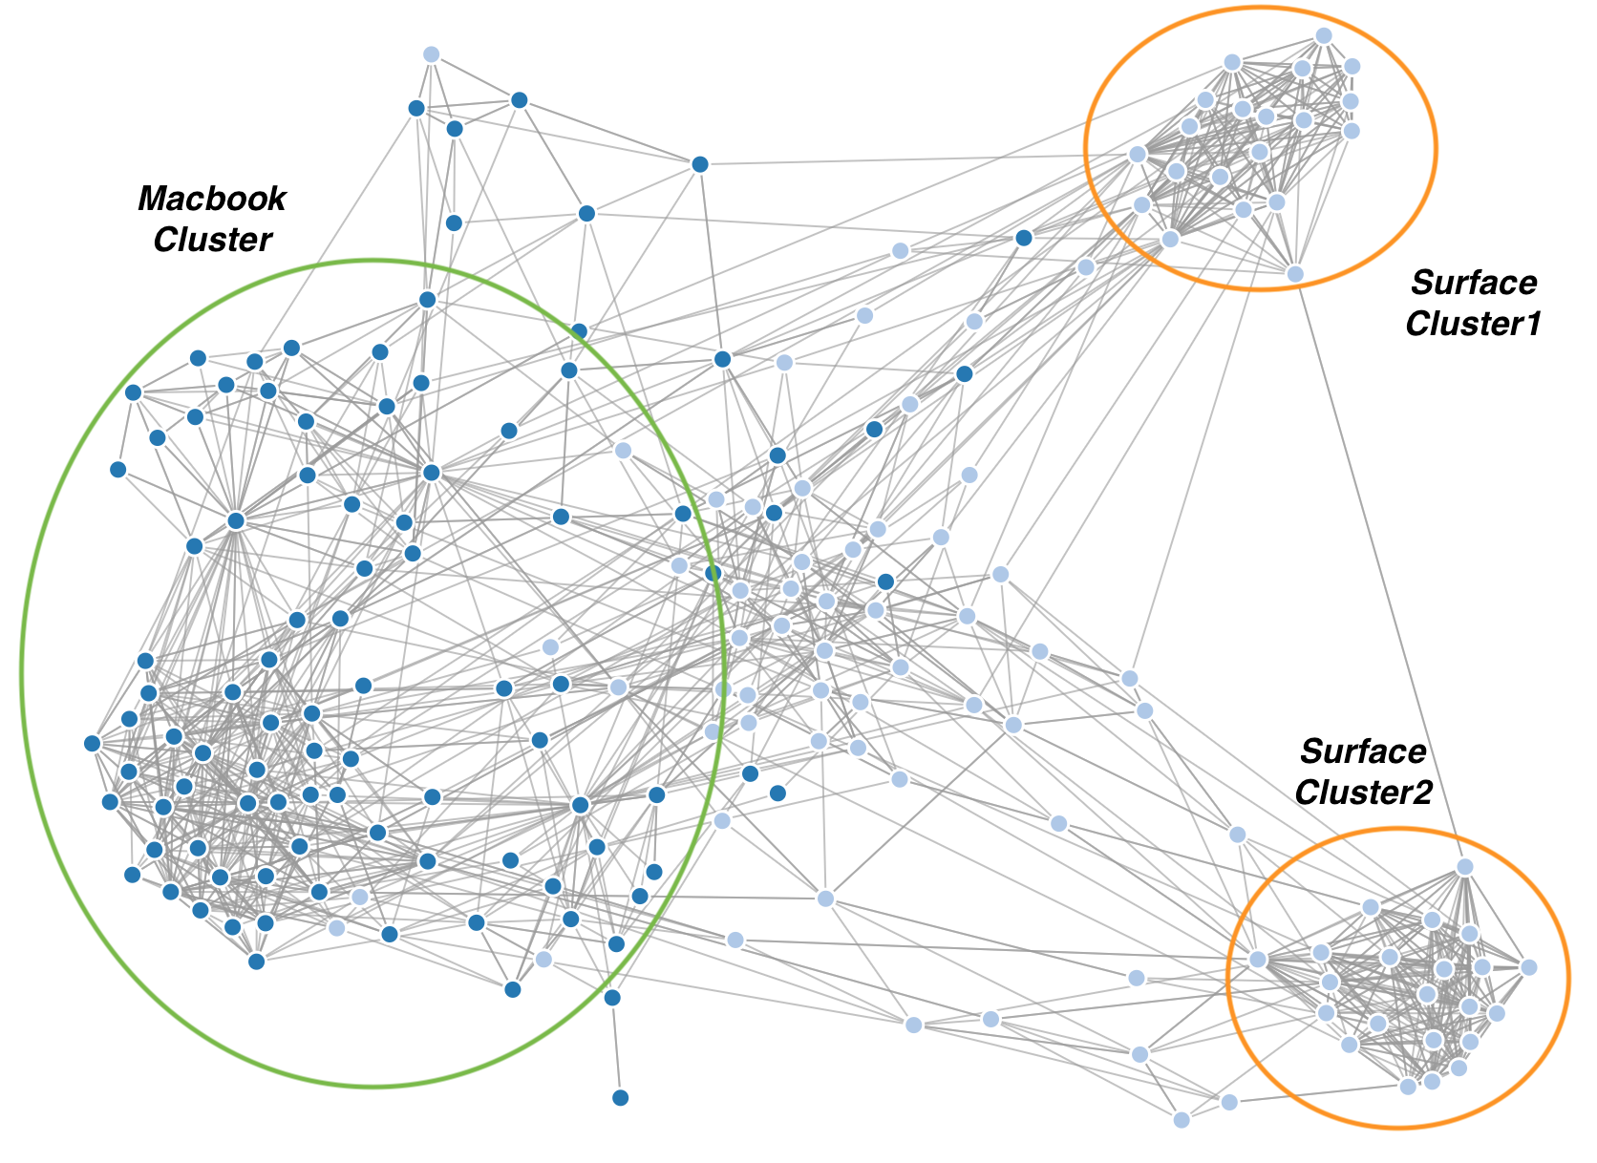

Slide 18
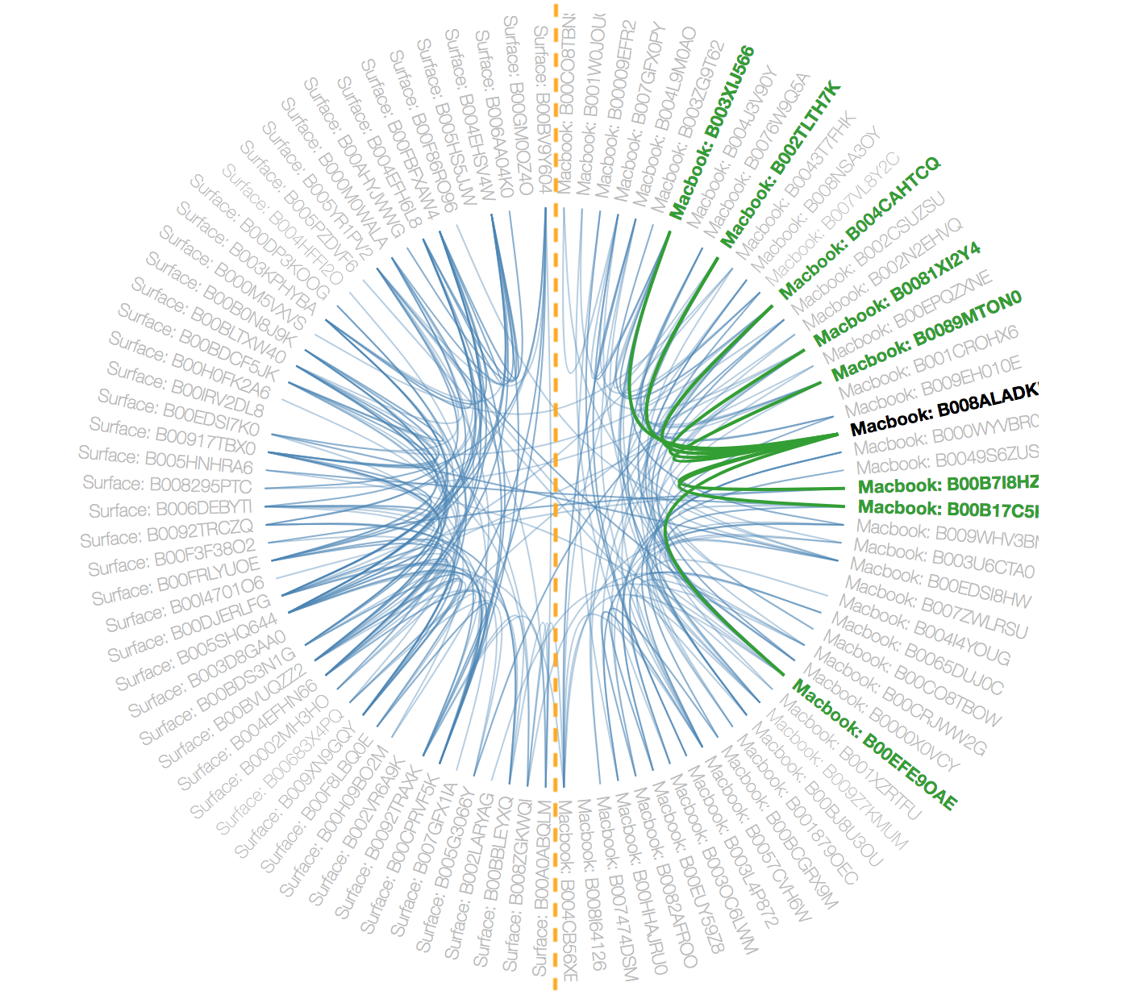
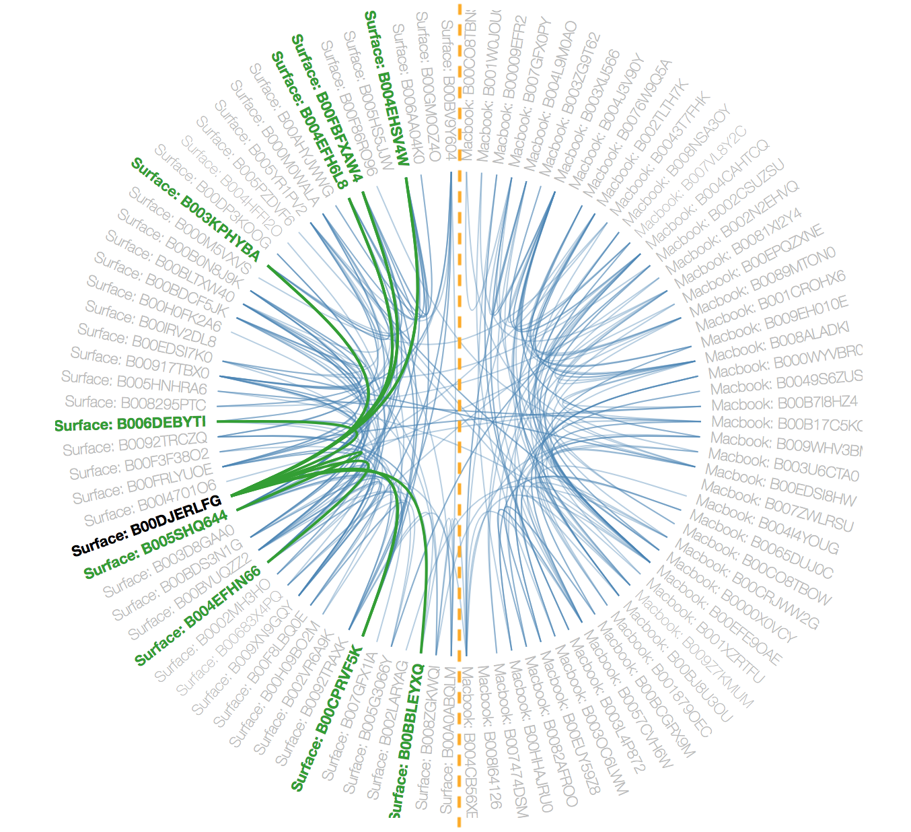
Circle-shaped Network
https://xiangzhemeng.github.io/ntds/index.html
MacBook
Surface

Slide 19
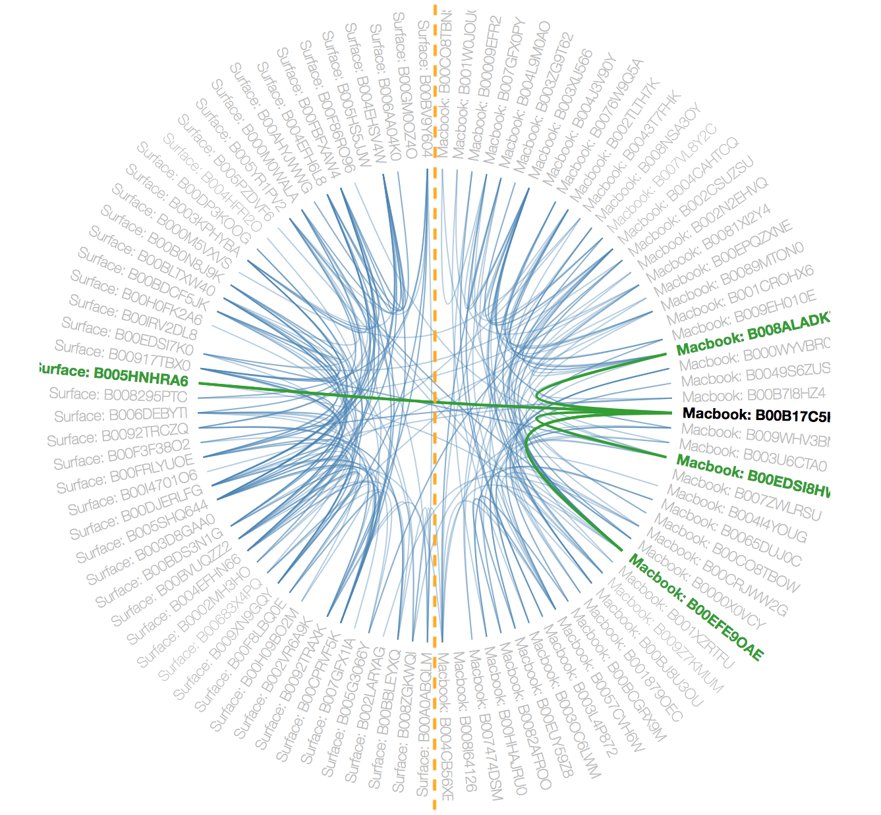
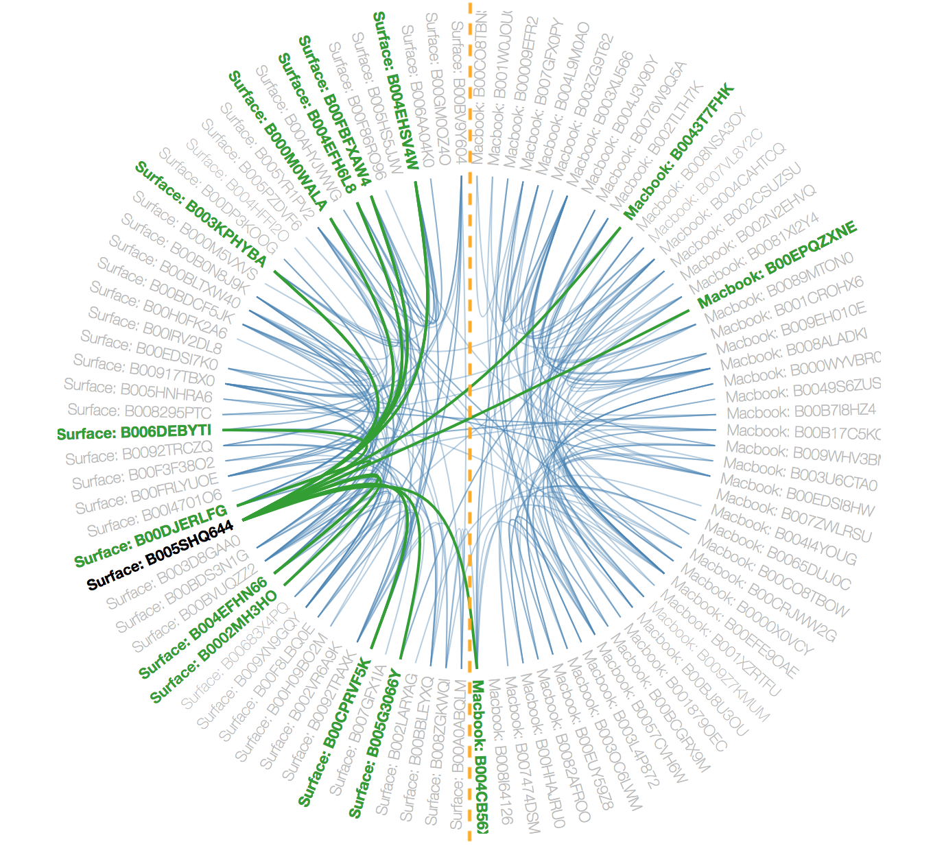
From MacBook to Surface
From Surface to MacBook

Slide 20
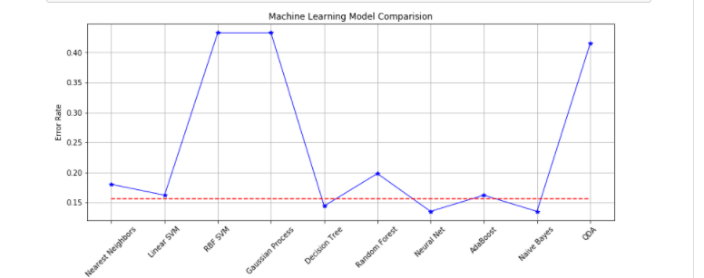
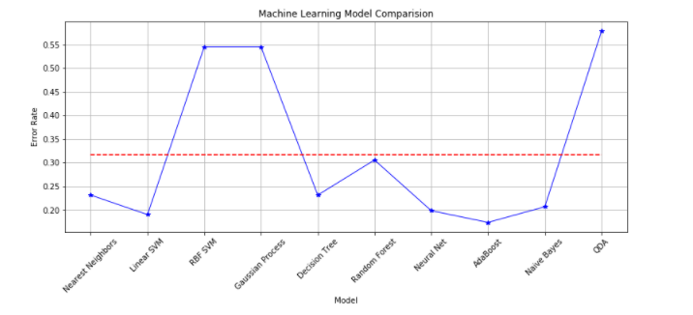
The result of 2 categories
The result of 3 categories

Slide 21
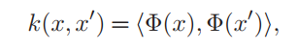
Why we achieve a curve like this? What difference makes the huge difference of error rates of different models?
Linear SVM and SVM
Soft-margin
classifier
Kernel method
Hinge loss
function
This allows the algorithm to fit the maximum-margin
hyperplane in a transformed feature space.
In fact, our data dimension is already very high and
we do not need to map it in a higher dimensional space.
When the data dimension and the sample number is similar,
using the kernel method is very easy to cause overfit.

Slide 22
And gaussian process isn’t suitable for data who has features more than several dozens.
QDA has more overfit problem even than SVM.
Decision tree can perform good,
but random forest makes it even worse!
Boosting has unstable influence of the decision tree!
What I recommend:
Neural net, which can work pretty well even without changing a lot of parameters.
Naive Bayes
Naive Bayes classifiers are a popular statistical technique of e-mail filtering.
It is good at dealing data has more features even than number of data!
It deals with data with a high dimensional feature!
Sometimes the feature is the same dimension of all English words!
It won’t easily overfit in this case! It works stable when clustering the graph!

Slide 23

Study on MacBook, Surface and ThinkPad
Surface
MacBook
ThinkPad

Slide 24
Collecting Products
Same method as before:
'also_bought' products
'also_products' of those products
~700, 500, 600 products in MacBook, Surface, ThinkPad group respectively.

Slide 25
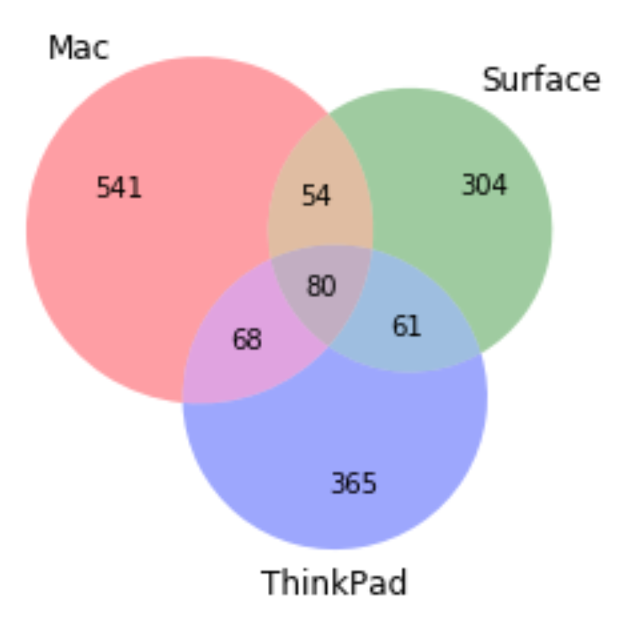

Slide 26
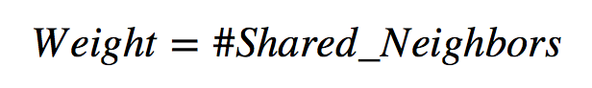
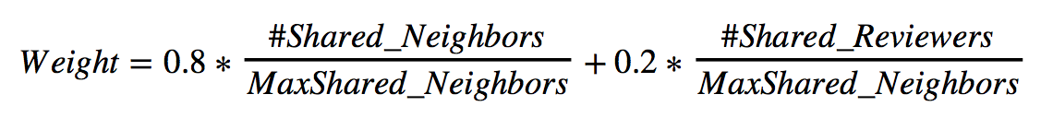
Creating Network
Same method as before:
Node: Product
Edge: If 'also_bought' with another product
Weights: Two methods:

Slide 27
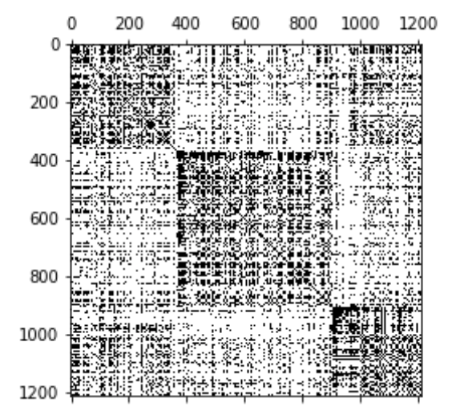
Laplacian (D-A)

Slide 28
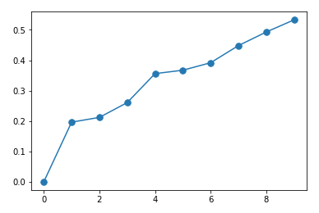
Eigenvalues

Slide 29
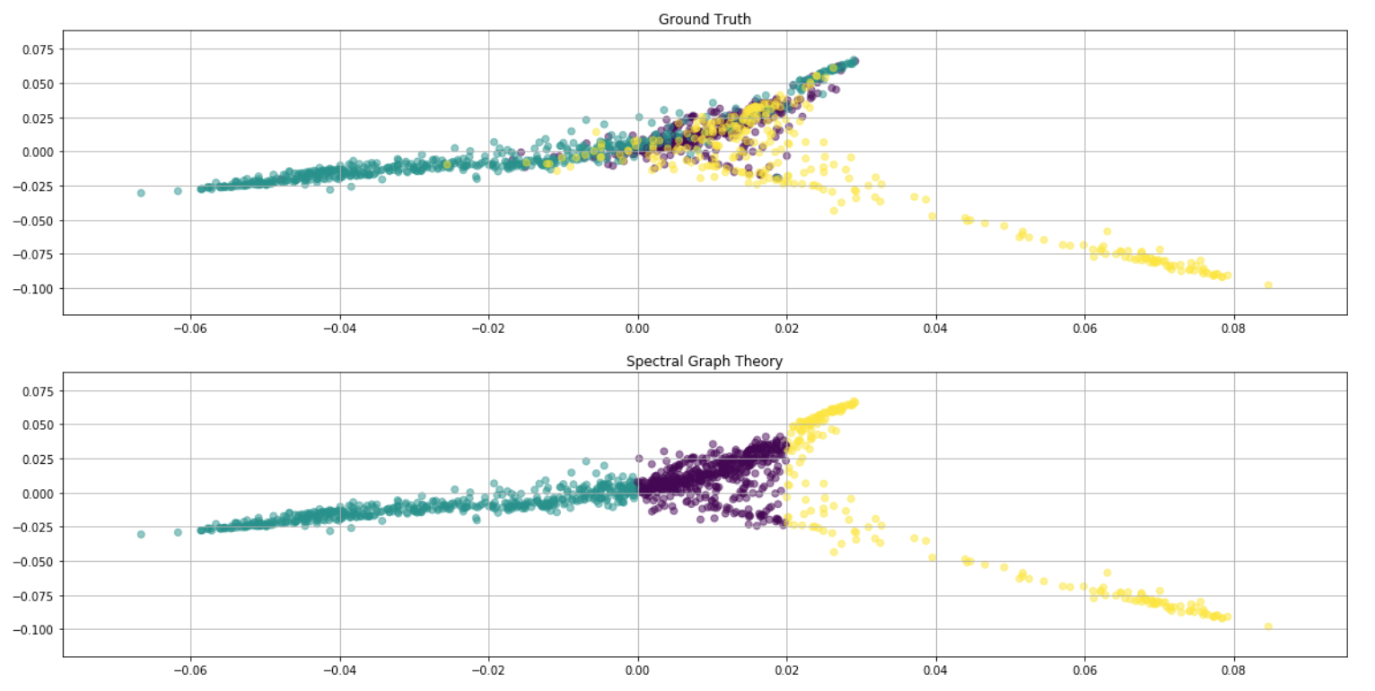
Graph with EigenValues (%29)

Slide 30
Transductive Learning
Alpha | Error (%)
0.1 | 49
0.3 | 33
0.5 | 24
0.7 | 13
0.9 | 4

Slide 31
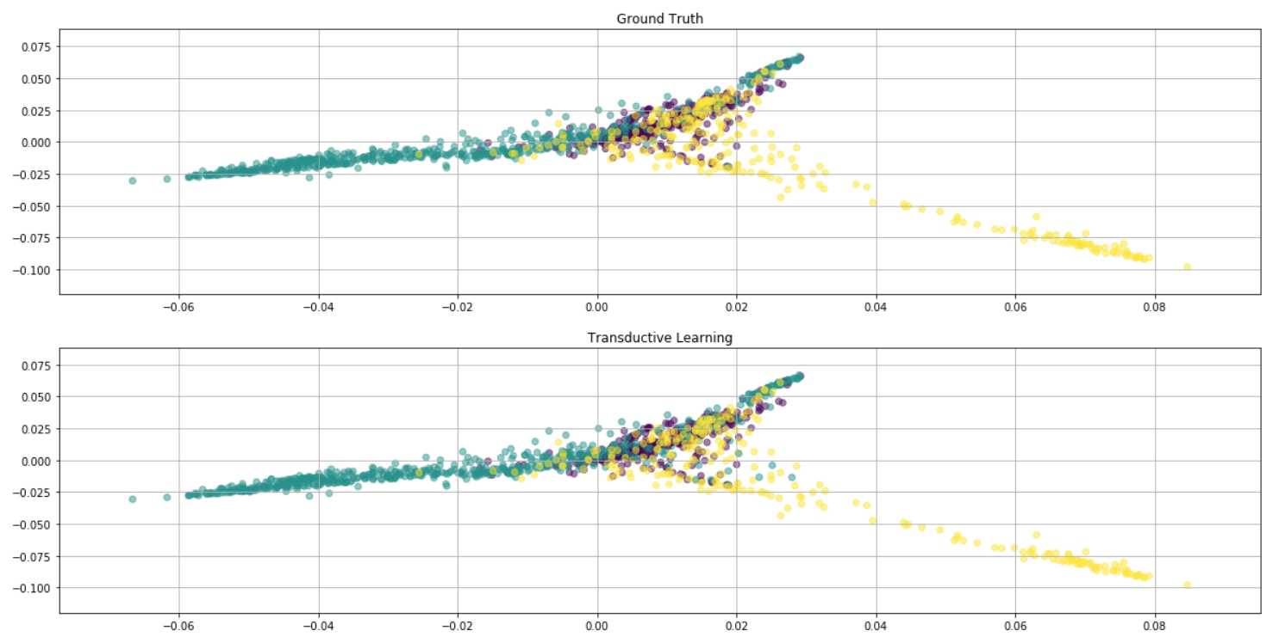
Transductive Learning (%13)

Slide 32
Conclusion
Spectral Graph Theory did a good job both in two-group and three-group classifications
The information of reviewers directly reflects the connection of two products
Manually chosen cores —> clusters may not be that obvious
How to label our datapoints right and meaningful becomes our further research direction
Thanks for your listening! Any questions?

